Slide 1
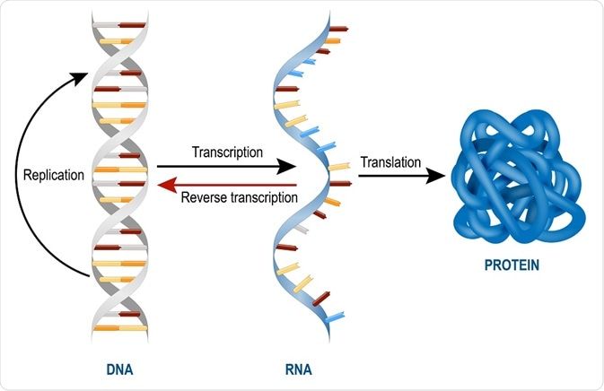
Introduction to RNA and Transcription

Slide 2
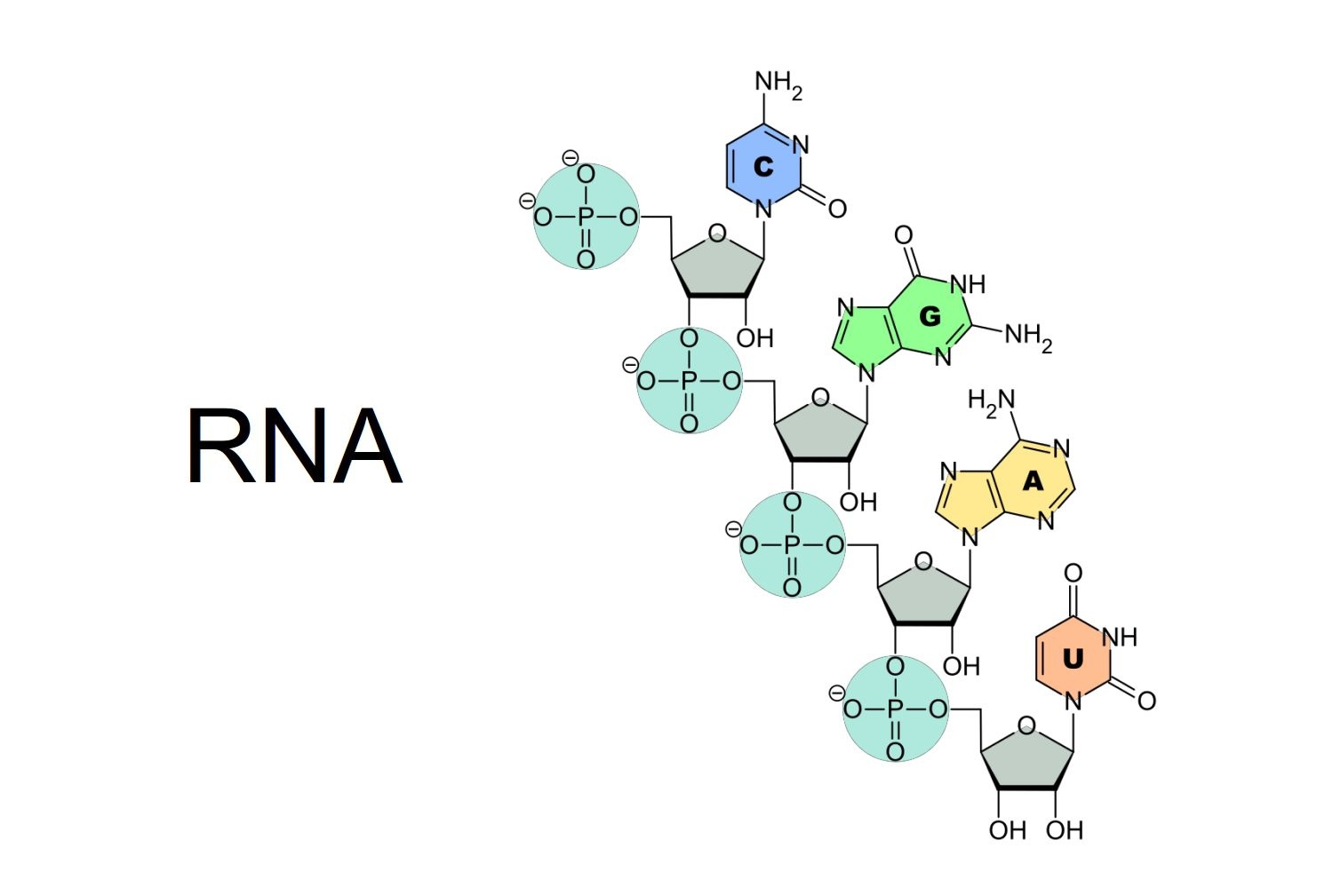
RNA
RNA is a polymer of ribonucleotides linked together by 3’-5’ phosphodiester linkage

Slide 3
RNA vs DNA
RNA | DNA
Single stranded mainly except when self complementary sequences are there it forms a double stranded structure (Hair pin structure) | Double stranded (Except for certain viral DNA s which are single stranded)
Ribose | Deoxyribose
Pyrimidine components differ. Thymine is never found (Except tRNA) | Thymine is always there but uracil is never found
Being single stranded structure, it does not follow Chargaff’s rule | It does follow Chargaff's rule. The total purine content in a double stranded DNA is always equal to pyrimidine content.
RNA can be easily destroyed by alkalis to cyclic diesters of mono nucleotides. | DNA resists alkali action due to the absence of OH group at 2’ position
RNA is a relatively a labile molecule, undergoes easy and spontaneous degradation | DNA is a stable molecule. The spontaneous degradation is very 2 slow. The genetic information can be stored for years together without any change

Slide 4
RNA vs DNA
RNA | DNA
Mainly cytoplasmic, but also present in nucleus (primary transcript and small nuclear RNA) | Mainly found in nucleus, extra nuclear DNA is found in mitochondria, and plasmids etc
The base content varies from 100- 5000. The size is variable. | Millions of base pairs are there depending upon the organism
There are various types of RNA – mRNA, r RNA, t RNA, Sn RNA, Si RNA, mi RNA and hn RNA. These RNAs perform different and specific functions. | There are variable forms of DNA (A to E and Z)
RNA is synthesized from DNA, it can not form DNA(except by the action of reverse transcriptase). It can not duplicate (except in certain viruses where it is a genomic material ) | DNA can form DNA by replication, it can also form RNA by transcription.
Many copies of RNA are present per cell | Single copy of DNA is present per cell.

Slide 5
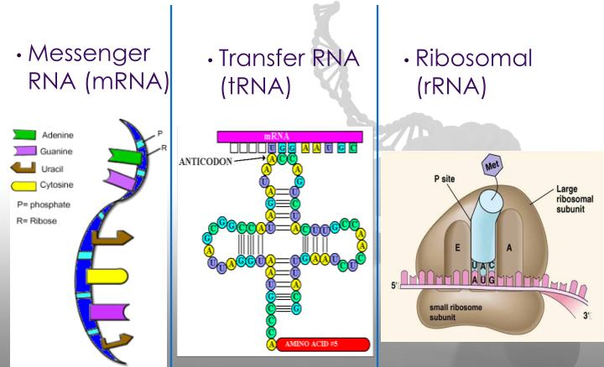
Types of RNA
Major types common in both prokaryotes and eukaryotes

Slide 6
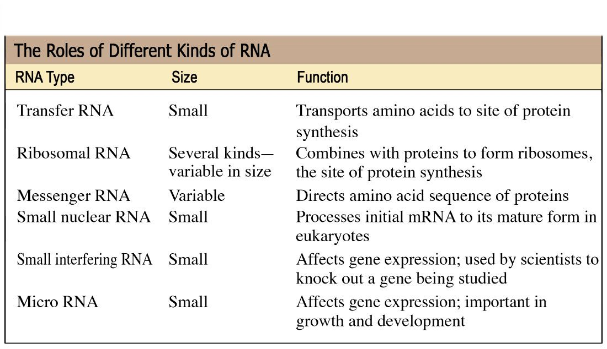
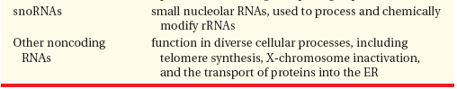
Types of RNA

Slide 7
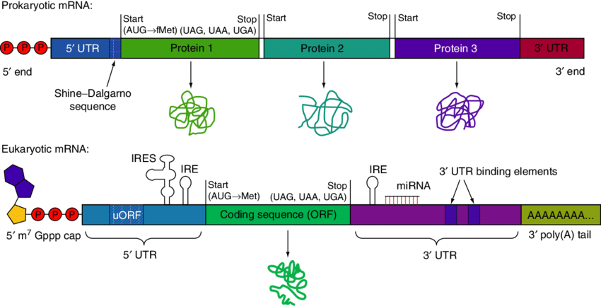
Messenger RNA (5% of total RNA)
Heterogeneous in size and stability
Carries the codons for specifying amino acid
Template for proteins synthesis
Polycistronic mRNA
monocistronic mRNA

Slide 8
Messenger RNA

Slide 9
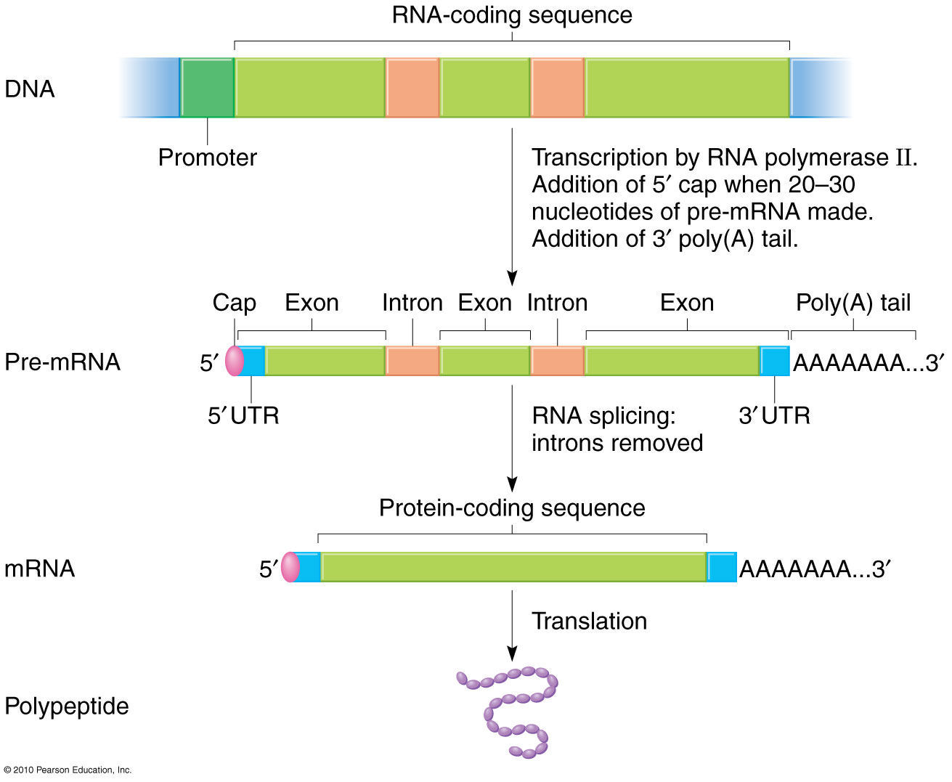
mRNA – eukaryotes

Slide 10
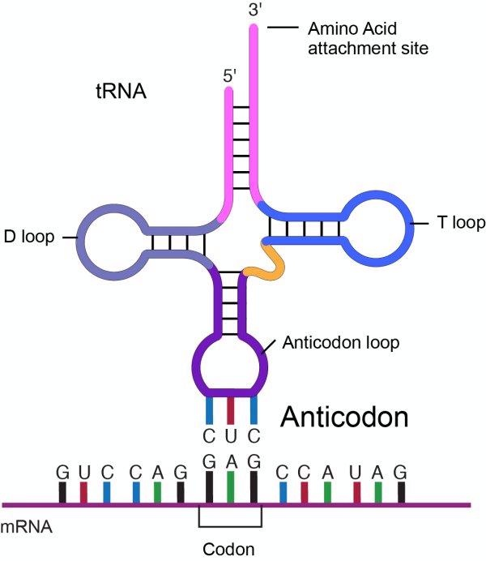
Transfer RNA
Smaller RNA of 76 to 90 nucleotides
Fold into tertiary structure by formation of intra-molecular base pairs
Have clover leaf shape (hair pin) and L shape
Carry amino acids to the ribosome
Adaptor molecule for transporting amino acids
Max 41tRNA are characterised
Variable arm

Slide 11
tRNA – Acceptor arm
The acceptor arm is at 3’ end
It has 7 base pairs
The end sequence is unpaired Cytosine, Cytosine-Adenine at the 3’ end
The 3’ OH group terminal of Adenine binds with carboxyl group of amino acids
The t RNA bound with amino acid is called Amino acyl t RNA
CCA attachment is done post transcriptionally
Variable arm

Slide 12
tRNA – Anticodon arm
Lies at the opposite end of acceptor arm
5 base pairs long
Recognizes the triplet codon present in the m RNA
Base sequence of anticodon arm is complementary to the base sequence of m RNA codon.
Due to complementarity it can bind specifically with mRNA by hydrogen bonds.
Variable arm

Slide 13
tRNA – other arms
DHU arm – 3-4bps, Serves as the recognition site for the enzyme (amino acyl t RNA synthetase) that adds the amino acid to the acceptor arm.
TψC arm – opposite to DHU arm, contains pseudo uridine, binding of tRNA to ribosome
Variable arm
Variable arm

Slide 14
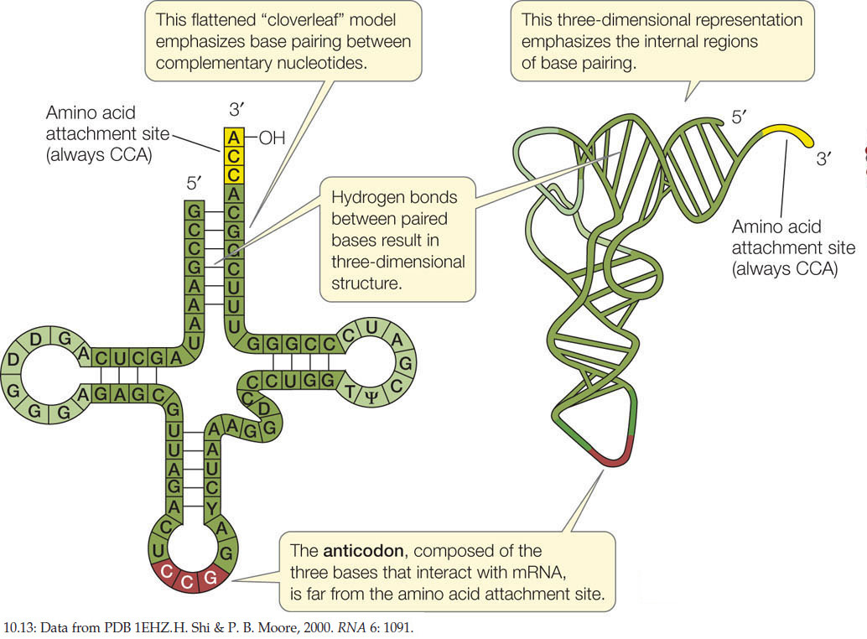
tRNA

Slide 15
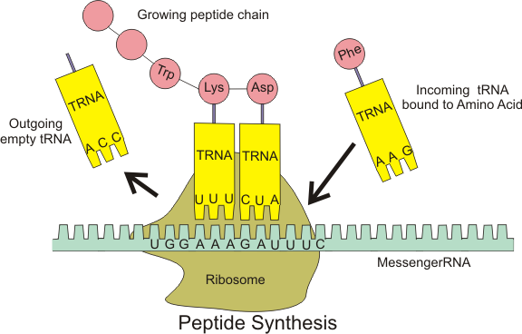
tRNA
Aminoacyl tRNA
(Activated form)

Slide 16
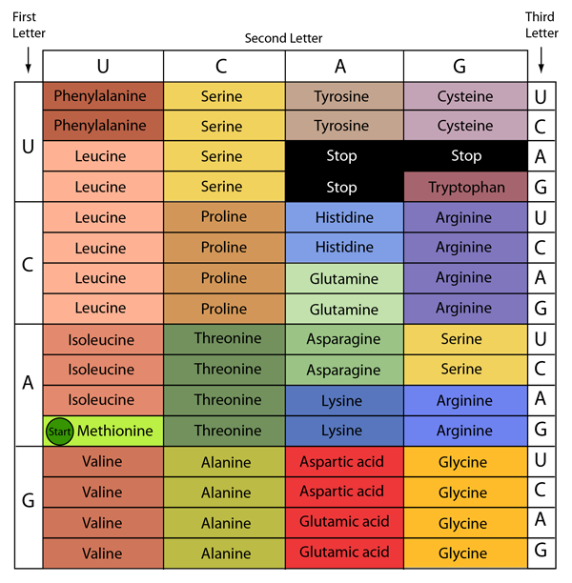
Genetic Code in mRNA

Slide 17
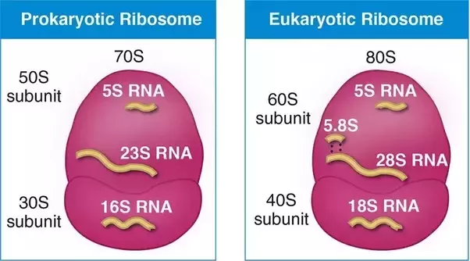
Ribosomal RNA
Structural and catalytic function
23srRNA – Peptidyl transferase activity

Slide 18
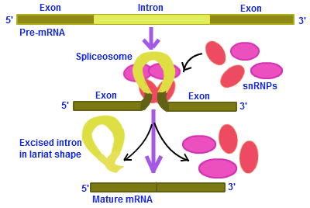
Other non-coding RNA
Small Nucleolar RNA – Processing of RNA’s

Slide 19
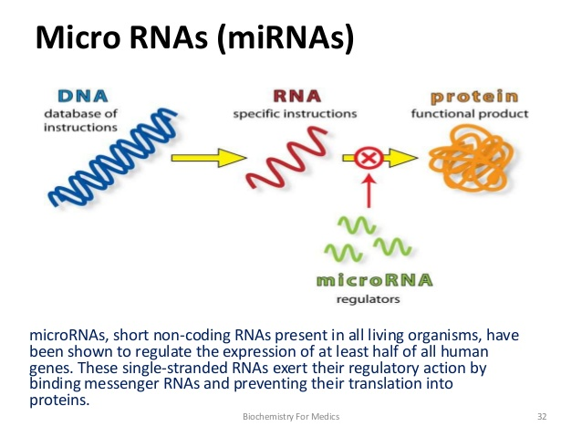
Other non-coding RNA

Slide 20
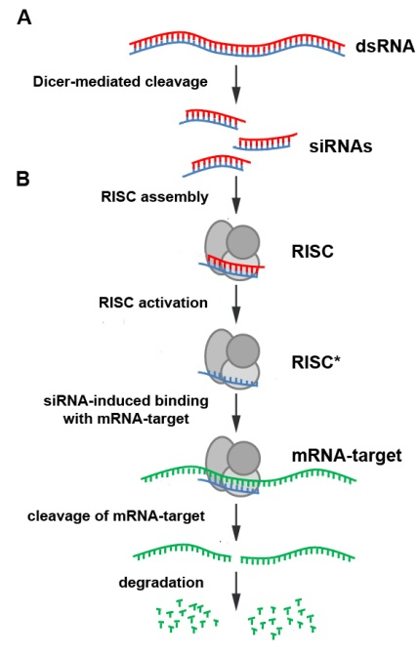
Other non-coding RNA
Small interfering RNA
Interferes the gene expression
Induces the cleavage of target mRNA

